Slide 1
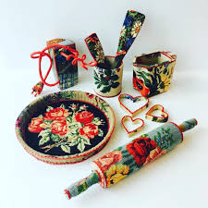
The Domestic Sonnet

Slide 2
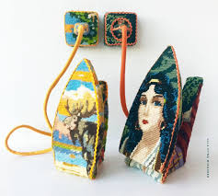
The English Sonnet

Slide 3
Basic Construction
Three sets of four lines each, called 'quatrains', plus a final set of two lines, a 'couplet'. Each stage in the development of the idea you want to explore in your poem can be marked by the shift from one group to the next.
The rhythm of a sonnet is iambic pentameter, which means that each line will contain five strong and five weak stresses, beginning with a weak:
ti-tum ti-tum ti-tum ti-tum ti-tum
Traditionally, sonnets rhyme abab cdcd efef gg

Slide 4
The Volta
Note that the rhyme scheme for the last two lines of a sonnet changes. The rhyme repeats rather than alternates. Apart from the obvious fact that two lines can’t alternate a rhyme scheme, there is a poetic reason for this.
The last two lines of a sonnet are called the volta and are traditionally used (as the word ‘volta’ suggests) to change the emphasis of the poem’s argument and thus, its meaning.

Slide 5
Shakespeare Sonnet 18
Shall I compare thee to a summer's day? a
Thou art more lovely and more temperate; b
Rough winds do shake the darling buds of May, a
And summer's lease hath all too short a date: b
Sometime too hot the eye of heaven shines, c
And often is his gold complexion dimm'd; d
And every fair from fair sometime declines, c
By Chance or Nature's changing course untrimm'd. d
But thy eternal summer shall not fade, e
Nor lose possession of that fair thou owest; f
Nor shall Death brag thou wander'st in his shade, e
When in eternal lines to time thou growest: f
So long as men can breathe, or eyes can see, g
So long lives this, and this gives life to thee. g
The volta, in which Shakespeare switches from addressing the beloved to writing about the poem itself and why he has written it.

Slide 6
Variations and Subersions
The sonnet in reverse
Sonnet Reversed by Rupert Brooke
Hand trembling towards hand; the amazing lights
Of heart and eye. They stood on supreme heights
Ah, the delirious weeks of honeymoon!
Soon they returned, and, after strange adventures,
Settled at Balham by the end of June.
Their money was in Can. Pacs. B. Debentures,
And in Antofagastas. Still he went
Cityward daily; still she did abide
At home. And both were really quite content
With Work and social pleasures. Then they died.
They left three children (besides George, who drank):
The eldest Jane, who married Mr. Bell,
William, the head-clerk in the County Bank,
And Henry, a stock-broker, doing well.

Slide 7
The Unrhymed Sonnet
Poem Not To Be Read At Your Wedding by Beth Ann Fennelly
You ask me for a poem about love
in lieu of a wedding present, trying to save me
money. For three nights I’ve lain under
glow-in-the-dark stars I’ve stuck to the ceiling
over my bed. I’ve listened to the songs
of the galaxy. Well Carmen, I would rather
give you your third set of steak knives
than tell you what I know. Let me find you
some other store-bought present. Don’t
make me warn you of stars, how they see us
from that distance as miniature and breakable,
from the bride who tops the wedding cake
to the Mary on Pinto dashboards
holding her ripe red heart in her hands.

